Slide 1
Portuguese school system
Public system

Slide 2
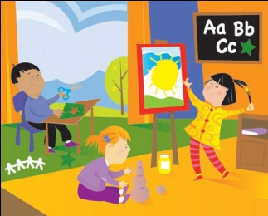
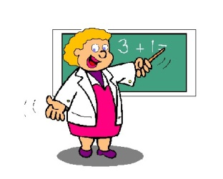
Pre-school
1 year
Pupils up to 5 years old
Primary school (1st cycle)
4 years
Pupils of 6 years old
2nd cycle
2 years
Pupils get different teachers for each subject

Slide 3
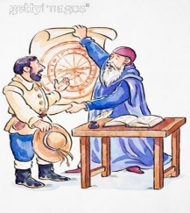
3rd cycle
3 years
Exams last year (portuguese and maths)
Secondary
3 years
Exams in 11th and 12th forms
University
Admission subject to exam marks
No longer a degree is a guarantee for a job

